Slide 1


We Think, Observe and Learn, therefore We Are
Webyfy IoT Private Limited
Advayam
An open Source
Hardware and Software Platform
Project Proposal
for financial assistance to pursue the
second stage of development and release
Vijay Kumar M.
CEO
Webyfy IoT Pvt Ltd
Vijay@Webyfy.com,
Mob: +91 9847923499
Our Products & Applications –
Idea Nurtured with Knowledge, Developed with Technology and Realized by People

Slide 2

Advayam
An Open-Source Learning. Prototyping and product creation platform
Webyfy IoT Pvt. Ltd. is an application technology R&D company based in Kerala, India, focused on developing scalable platforms for IoT, education technology, and embedded systems.
It has created three streams of interconnected technologies
REACH is Webyfy’s modular IoT technology framework, comprising hardware and software components that can be configured like LEGO blocks to rapidly create scalable IoT solutions across multiple domains. Its intelligent configuration and rule engines define solution architecture and behaviour, integrating sensors, actuators, external data, and audio-visual systems. https://iot.webyfy.com/
eGurukulam is an IEoT (Internet of Education Things) platform combining learning management and delivery in an offline-first architecture. It supports smart classrooms, teacher and student portals, learning delivery and assessment, and networking of thousands of geographically distributed classrooms.
https://entegurukulam.com/
Advayam is an open embedded development platform designed as an Arduino-compatible alternative, using indigenous microcontroller technology. It supports C, C++, Arduino, Rust, MicroPython, FreeRTOS, and Zephyr RTOS on the same hardware, with modular boards and HATs for experimentation and rapid prototyping. https://www.advayamtech.in/

Slide 3
Advayam
An Open-Source Learning. Prototyping and product creation platform
ADVAYAM is an open, scalable and future-ready embedded development ecosystem consisting of both hardware and software systems that empowers innovation in education, research, prototyping and industrial product development.
Webyfy IoT has developed ADVAYAM as an open-source project to:
Democratise advanced embedded computing
Enable multi-language and multi-framework development
Bridge the widening gap between academia and industry
Provide a seamless alternative to legacy prototyping ecosystems
Support next-generation IoT and edge computing applications
Provide indigenous microcontrollers designed and released by Indian companies to have a platform to prove the performance and application worthiness by building a base module with Advayam specifications. For example – VEGA processor by CADC being integrated.
Help set up Centres of Excellence for IoT in universities in a hub-and-spoke model using Advayam technology to bridge the diverging gap between academia and Industry
Advayam is intended to be a platform for ingeniously developed microcontrollers
using which they can prove their usefulness and reliability with little effort.
Advayam combines Arduino simplicity with industrial-grade embedded intelligence

Slide 4
Advayam
An Open-Source Learning. Prototyping and product creation platform
Designed for All Levels of Learning
Level | Learning Tools | Outcomes
School (K-12) | Advayam Junior App | Logic building, sensors, LED/Motor control
Under graduate | VSCode + Advayam Extension, Arduino, Web IDE, Simulators | Hardware interfacing, real-world projects
Post graduate | Rust, ESP-IDF, Free RTOs, Zephyr RTOS, Web IDE, Simulators | Research, low-level control, networked systems
Advayam’s primary stage testing module is released with support for C, C++, Arduino and FreeRTOS programming

Slide 5
Advayam – Partial Comparative Study
 | Aspect | Arduino | Advayam
I | Platform Philosophy
1 | Core Philosophy | Simple electronics prototyping | Unified embedded systems ecosystem
2 | Primary Focus | Education & makers | Education + Industrial + Research
3 | Ecosystem Style | Microcontroller-centric | Microcontroller-centric
4 | Learning Curve | Beginner-friendly | Beginner to advanced
5 | Scalability | Moderate | High
6 | Embedded OS Support | Limited | Native RTOS ecosystem
II | Processing Architecture
7 | Typical MCU | AVR / ARM | ARM / RISC-V / Multi-core
8 | Processing Capability | Low to medium | Low - Medium – very high
9 | Real-Time Capability | Basic | Advanced
10 | Multi-core Support | Limited | Supported
11 | AI Acceleration | Minimal | Supported / Expandable
III | Memory & Storage
12 | Flash Memory | 32 KB (Uno) | MB-scale expandable
13 | SRAM | 2 KB | Large SRAM support
14 | External Storage | Limited | Native expansion support
15 | Filesystem Support | Minimal | Advanced
IV | Programming Languages and IDE
16 | Arduino Framework | Yes | Yes
17 | C | Yes | Yes
18 | C++ | Yes | Yes
19 | MicroPython | Limited | Native
20 | FreeRTOS | Partial | Native
21 | Zephyr RTOS | Rare | Fully supported
 | Aspect | Arduino | Advayam
V | RTOS Capability
22 | Native RTOS Support | Minimal | Native
23 | Task Scheduling | Limited | Advanced
24 | Industrial Automation Ready | Limited | Yes
VI | Learning Model
25 | Beginner Friendly | Excellent | Excellent
26 | Advanced Embedded Learning | Moderate | Extensive
27 | RTOS Education | Limited | Strong
28 | IoT Education | Moderate | Advanced
29 | AI Edge Learning | Limited | Supported
VII | Community & Ecosystem
30 | Global Community | Massive | Emerging
31 | Open-source Libraries | Extensive | Planned/Open
32 | Educational Resources | Extensive | Expandable
33 | Industrial SDKs | Limited | Planned
VIII | Use Case Comparison
34 | STEM Education | Excellent | Excellent
35 | Smart IoT Devices | Moderate | Excellent
36 | Industrial Automation | Limited | Strong
37 | Robotics | Moderate | Strong
38 | AI Edge Devices | Weak | Strong
39 | Research Platforms | Moderate | Excellent
40 | Product Development | Moderate | Excellent
All these features are designed into the system by choosing suitable hardware and software framework – modules are being rolled out.

Slide 6
Advayam
An Open-Source Learning. Prototyping and product creation platform
Boards Released and to be Released
SI No. | Advayam board names | MCU Used | Manufacturer | Manufacturer Part Number | Functionality
1 | Advayam ESP32S3 Starter Kit | ESP32-S3-WROOM-1 | Espressif Systems | ESP32-S3-WROOM-1-N16R8 | Beginner-friendly embedded systems learning, Hands-on IoT education, Programming fundamentals • Sensor interfacing experiments • Display and peripheral interfacing • Wireless communication learning
2 | Advayam RA4M1 SK | R7FA4M1AB3CFM | Renesas Electronics | R7FA4M1AB3CFM#AA0 | Advayam RA4M1 SK combines Arduino UNO R3 shield compatibility, an onboard LED matrix, and comprehensive communication interfaces. An ideal platform for robotics, automation, IoT solutions, embedded learning, and rapid product development.
3 | Advayam RP2354 Base Board – (Under development) | RP2354B | Raspberry PI | RP2354B | A powerful and scalable RP2354 development platform with compatibility for Arduino shields and Advayam custom expansion boards. Engineered for embedded innovation, robotics, IoT, automation, education, and next-generation product development.
4 | Advayam Thejas32 Base Board – (Under development) | THEJAS32 SoC | VEGA Processor | THEJAS32 | An indigenous RISC-V development platform with support for Arduino-compatible shields and Advayam custom expansion shields. Ideal for RISC-V software development, embedded research, industrial automation, robotics, and next-generation indigenous product development. and promoting Made-in-India embedded solutions.
5 | Advayam R5F566 and R7FA8M Base Boards (Under the project) | R5F566 and R7FA8M | Renesas Electronics | R5F566NDHGFP#30 | A high-performance AI and Machine Learning development platform by the Renesas RX66N MCU. Designed for Edge AI, intelligent robotics, industrial automation, computer vision, and real-time embedded applications.
Two machine learning-capable modules will be created under the project with R5F566 and R7FA8M microcontrollers

Slide 7
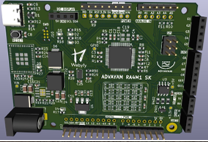
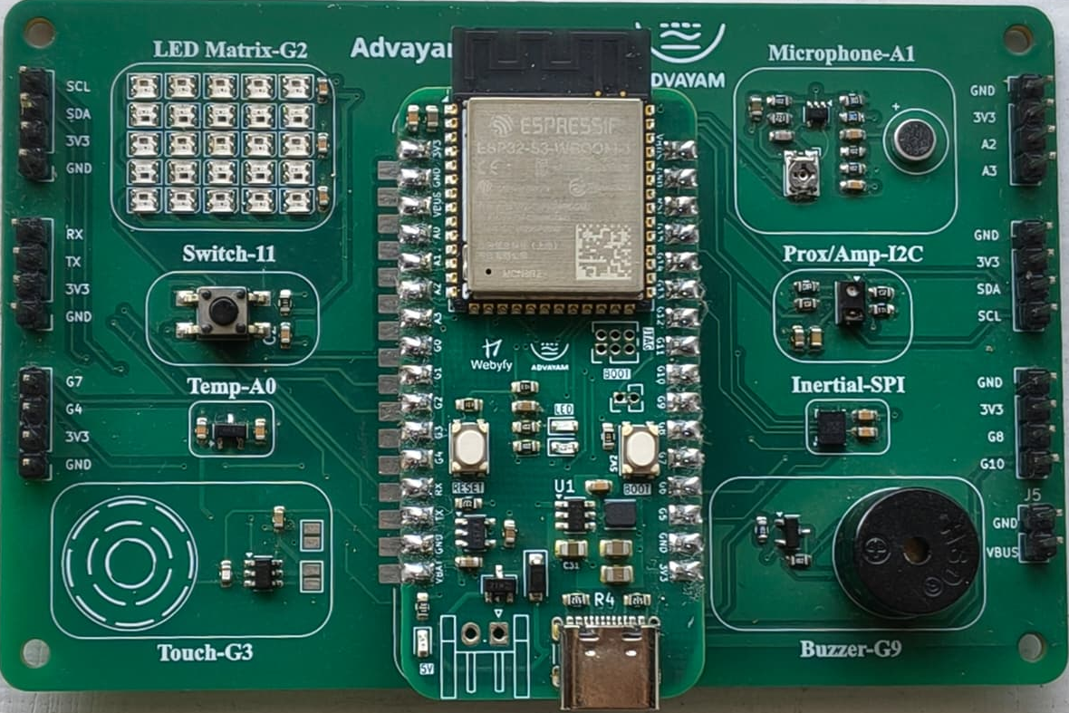
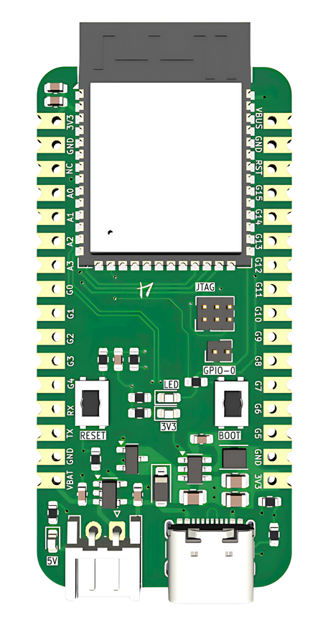
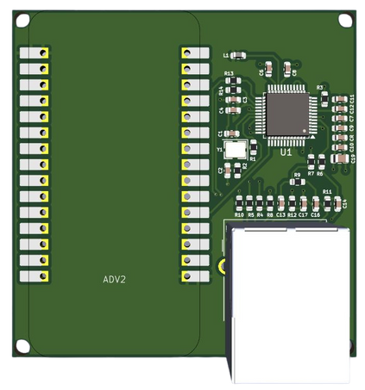
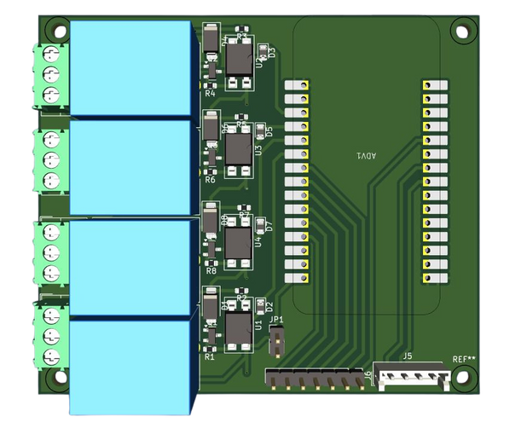
Advayam
An Open-Source Learning. Prototyping and product creation platform
Boards Released
ADVAYAM Renesas RA4M starter kit
ADVAYAM STARTER KIT
ESP32-S3
ADVAYAM ETHERNET BOARD – Test modules
ADVAYAM 4 CHANNEL RELAY BOARD - – Test modules
ADVAYAM ETHERNET BOARD
ADVAYAM 4 CHANNEL RELAY BOARD

Slide 8
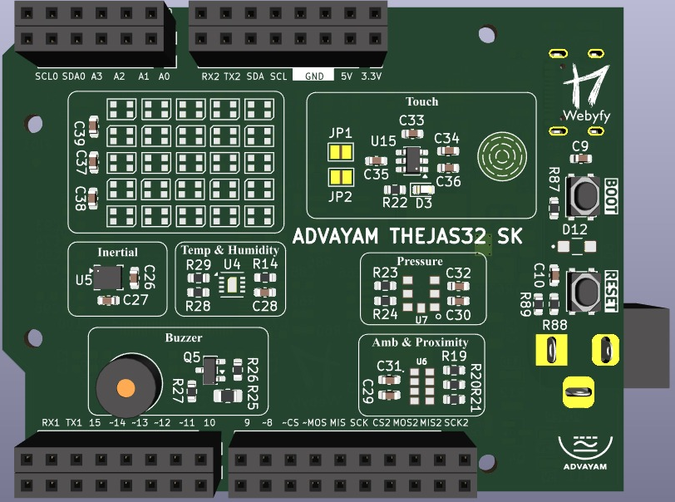
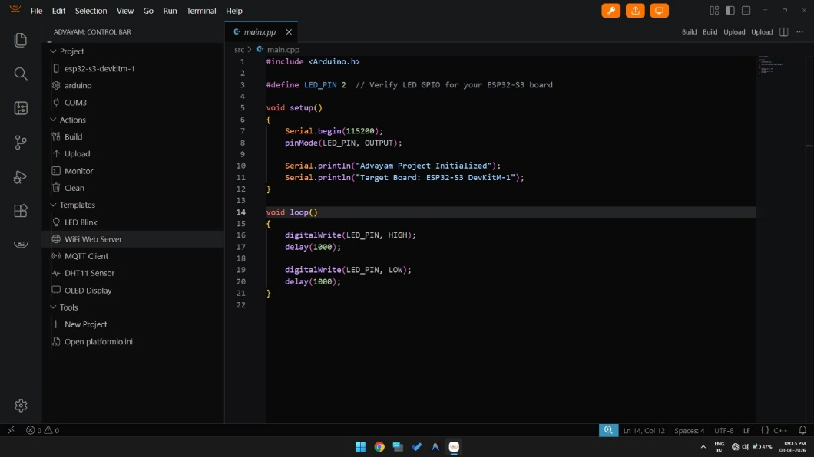
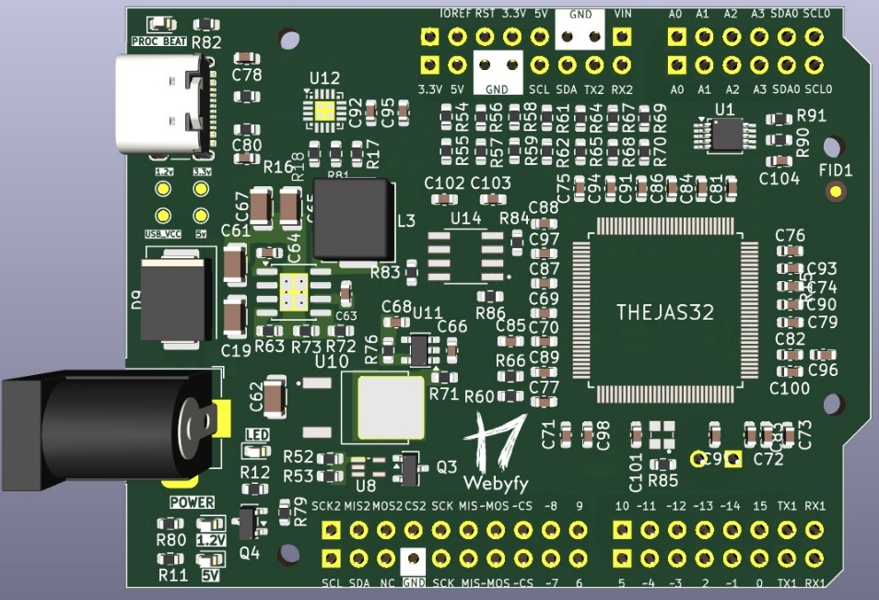
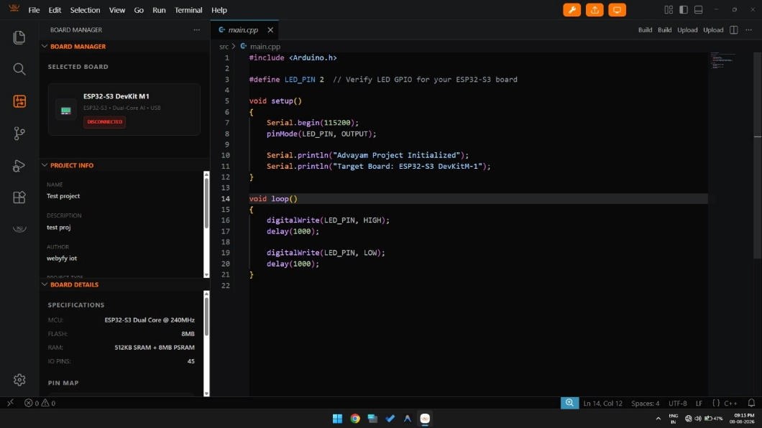
Advayam Thejas board based on VEGA microcontroller
developed by CDAC, Govt of India
Advayam Integrated Development Environment (IDE) for C, C++, Arduino and Free RTOS
Advayam Control Menus
Top Side
Board Manager Section
Bottom Side

Slide 9
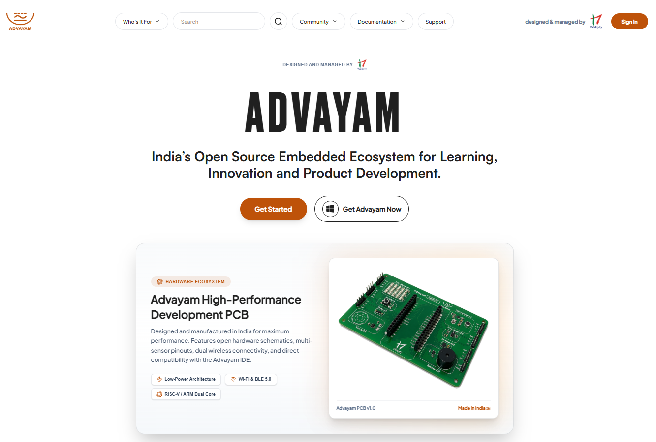
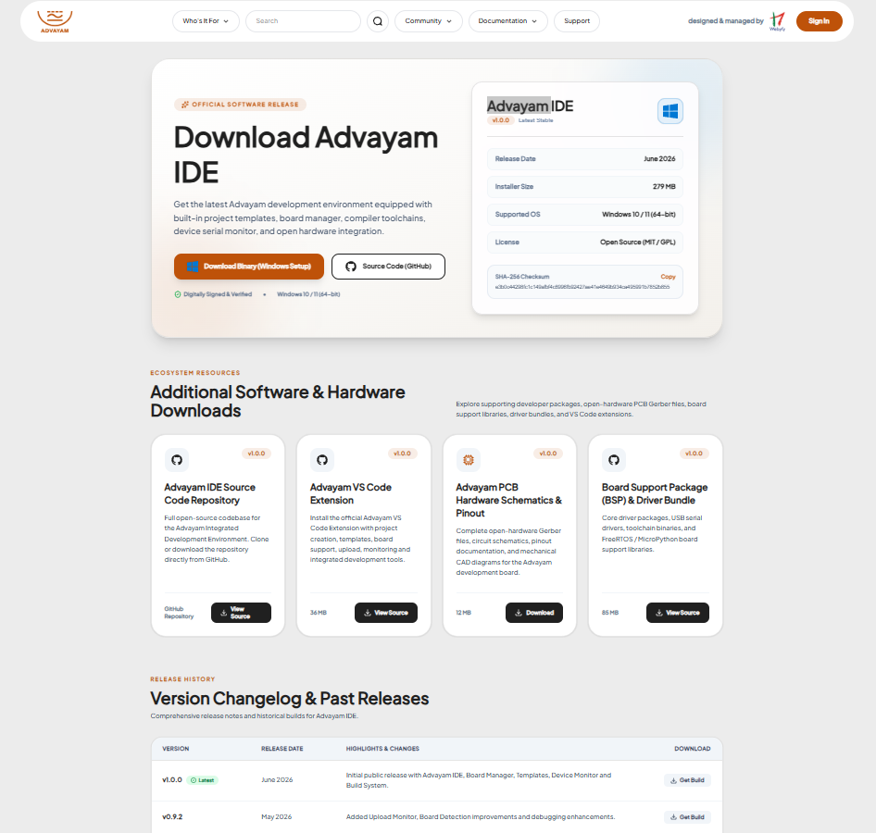
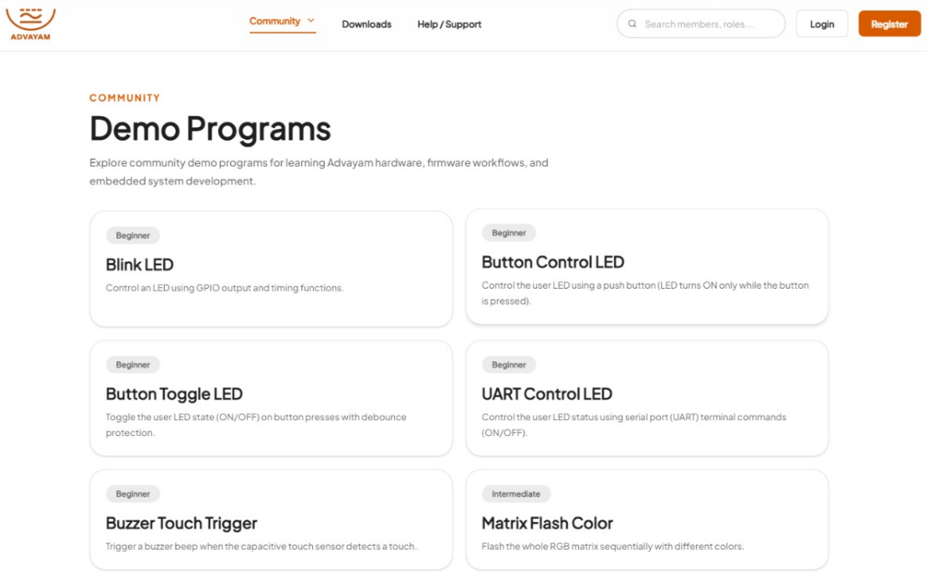
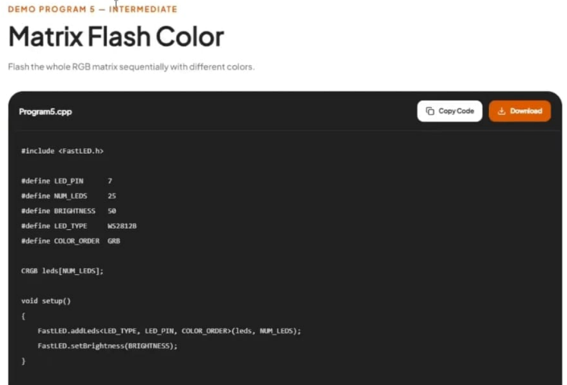
Advayam – https://www.advayamtech.in/
Demo Programs page
LED Flasher Demo program

Slide 10
Advayam
An Open-Source Learning. Prototyping and product creation platform
What does the project proposal envisage?
The following has been achieved
  The concept has been proved
  The technology framework has been finalised and tested
  Hardware architecture has been finalised
  PCB modules developed using multiple microcontrollers
  IDE technology conceptualised
  IDE developed for C, C++, Arduino and FreeRTOS
  Over 150 applications for learning and testing created
  Website created
  Support relationship with Renesas and CDAC established
The project envisages enhancements as follows
Create base modules with advanced microprocessors to enable ML and EDGE AI.
Create multiple HATS / Shields to experiment with different aspects of prototyping and development
Develop IDEs for RUST, MicroPython, and Zephyr RTOS for developing industrial-grade, ML and EDGE AI apps
Develop over 500 applications of various types for students and practitioners to experiment
Develop a significant number of mechanical systems controlled by Advayam modules like a robotic arm, etc
Develop a community of over 1000 developers and spread to multiple universities
Develop an online course for educating the basic electronic design & development, and usage of Advayam

Slide 11
Advayam
An Open-Source Learning. Prototyping and product creation platform
Plug-in HATs (Shields) being released under the project
 | Advayam Shields | Functionality
1 | Maker & Robotics Shield | • 4 DC Motor Driver • Servo Headers (4Channels) • Joystick Module • RGB Status LEDs • GPIO Expansion Headers • I²C/SPI/UART Breakout • 6 Digital input pins • Potentiometer • Encoder Input
2 | Human Interface Shield | • TFT Display Interface • Capacitive Touch pads • 4×4 Matrix Keypad • RGB Status LED • Navigation Joystick • Keypad Interface • microSD Card Slot • Audio/Buzzer Output
3 | Connectivity & IoT Shield | • 2 W5500 Ethernet • CAN Bus • 4 RS485 Interface • Zigbee/XBee • GPS Interface • GSM Module • NFC/RFID Support
 | Advayam Shields | Functionality
4 | Vision & AI Shield | • Camera Connector • Digital MEMS Microphone • Speaker Output • Audio Amplifier • IMU Sensor • Gesture Sensor • microSD • Status Buttons
5 | Industrial & Automation Shield | • 4Relay Outputs • Opto-Isolated Inputs • Analog Input Channels • Digital I/O Expansion • Industrial Sensors Interface • Current & Voltage Monitoring • CAN/RS485 Communication • Protected Power Interface • Prototype Area
6 | Advayam Motion Control Shield | • 4-Channel Stepper Motor Driver • Encoder Inputs • Limit Switch Inputs • Servo Outputs • PWM Outputs • DIR/STEP Control Signals • Emergency Stop Input • Status LEDs • I²C / SPI / UART Expansion Headers • GPIO Expansion Headers

Slide 12
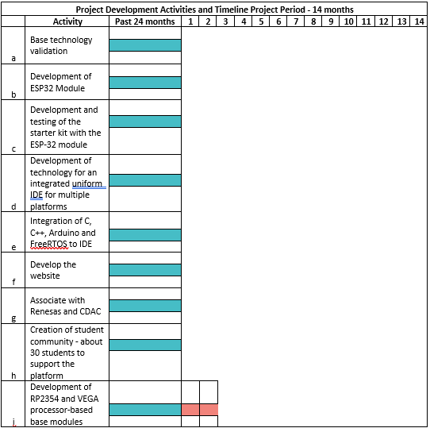
Advayam
An Open-Source Learning. Prototyping and product creation platform
Project Development activities and Timeline –
Targeted duration 14 months ending 12-2027

Slide 13
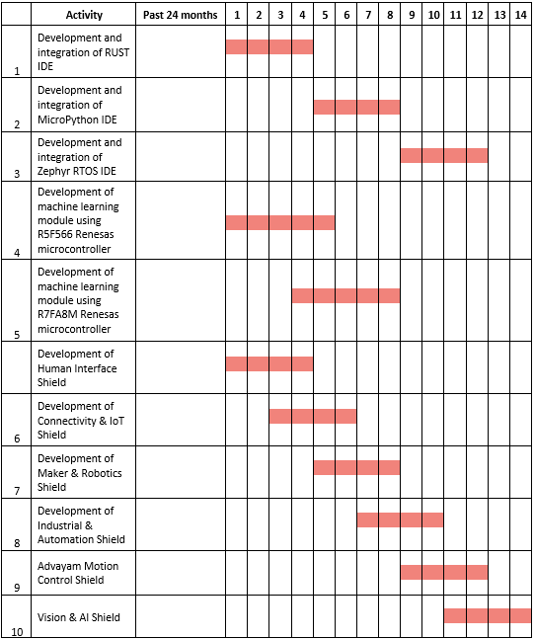
Advayam
An Open-Source Learning. Prototyping and product creation platform
Project Development activities and Timeline –
Targeted duration 14 months ending 12-2027

Slide 14
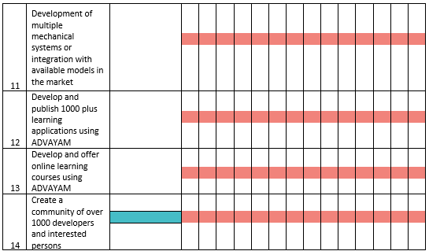
Advayam
An Open-Source Learning. Prototyping and product creation platform
At the end of the project, Advayam is slated to take on Arduino in its full might

Slide 15
Advayam
An Open-Source Learning. Prototyping and product creation platform
Total Project estimated cost is Rs 55 lakhs,
out of which Webyfy shall contribute Rs 15 lakhs NOT considering the contributions already made
 | Expenditure Head | Total Cost (₹) | Grant-in-Aid Sought (₹) | Applicant Contribution (₹) | Details
1 | Deployment & Integration in Live | 18,00,000 | 15,00,000 | 3,00,000 | Manpower cost, Logistics for demonstrations and evangelisation of Advayam among the student community
2 | Environment | 0 | 0 | 0
3 | Equipment & Software Requirements | 10,00,000 | 6,00,000 | 4,00,000 | Equipment like a 4-channel DSO, a desktop multimeter, Analogue simulator license, etc.
4 | Testing, Monitoring & Validation | 5,00,000 | 3,00,000 | 2,00,000 | Design and fabrication of testing facility, rigging up Test systems and testing facility in the labs
5 | Network Usage & Operational Costs | 3,00,000 | 1,00,000 | 2,00,000 | Internet charges, Online AI engine rental charges, power and other charges
6 | Certification (if applicable) | 0 | 0 | 0
7 | Other - Component purchase, PCB fabrication, Logistics | 19,00,000 | 15,00,000 | 4,00,000 | PCB fabrication, component purchase cost, soldering cost, cost of Arduino module for experimentation, Assembly cost, Purchase / 3D print mechanical systems to integrate the modules
 | Total in INR | 55,00,000 | 40,00,000 | 15,00,000 | Webyfy contribution shall be Rs 15 lakhs

Slide 16
Advayam
An Open-Source Learning. Prototyping and product creation platform
Advayam represents the evolution of embedded systems development — combining the simplicity of Arduino with the power of modern embedded computing frameworks.
By supporting multiple programming languages, real-time operating systems, IoT integration, and scalable hardware architectures, Advayam creates a unified ecosystem for education, research, innovation, and industrial product development.
Advayam is not merely an alternative to Arduino — it is a next-generation embedded development platform designed for the future of connected intelligent systems.
With the financial support, we are confident we can create a robust, extensive, and superior alternative to Arduino that will help students learn the latest advances in embedded technology.
Also enable the development community to create hundreds of products and solutions with ease.
Webyfy also suggests Advayam as a tool to bridge the widening gap between academia and Industry in the field of electronics technology/applications/product development
Advayam is intended to be a platform for ingeniously developed microcontrollers
using which they can prove their usefulness and reliability with little effort.

Slide 17


https://iot.webyfy.com/
Thank you

